Slide 1
Edgemont & Upper Capilano Community Association Annual General meeting March 14th, 2012 Agenda
1. EUCCA Annual Financial Report
2. ELECTION of 2012 Executive
3. RCMP Sgt. De Vries Presentation of Police Issues
4. CANFIELD 130 Unit Independent Seniors Rental Proposal – Chuck Brooks
Coffee Break (Courtesy Delany’s)
OTHER VILLAGE DEVELOPMENTS – Credit Union; Garden Works; Petro Canada; Village Banners.
GENERAL UPPER CAPILANO DEVELOPMENT ISSUES – Delbrook/William Griffin Rec Centre Replacement; Capilano Road & Highlands Blvd Bicycle Lanes; Capilano Water Project Traffic; Impact of New OCP on Edgemont Village

Slide 2
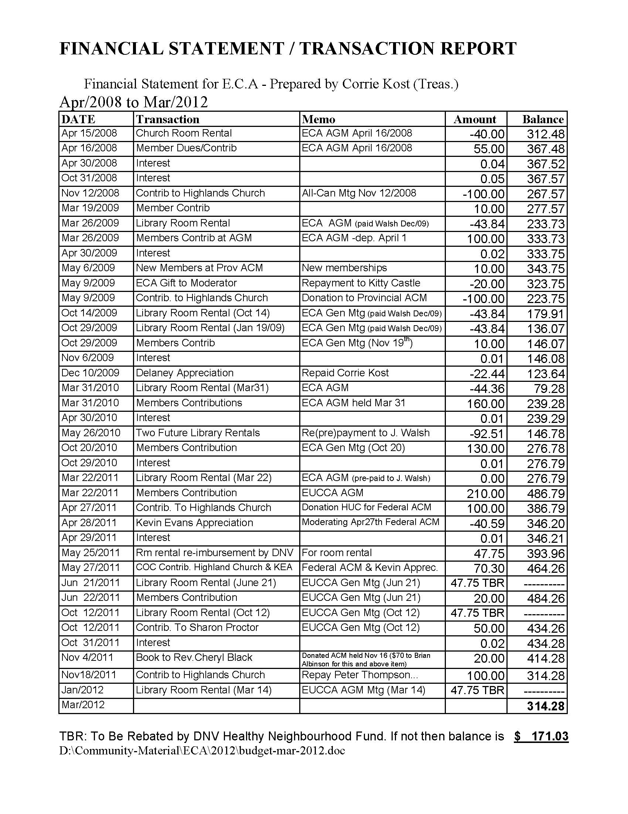
EUCCA Mar/2012 Financial Report

Slide 3
Election of Executive Board
Current Members
Brian Albinson
Grig Cameron
Ron Johnstone
Corrie Kost
Louise Nagle
Brian Platts
Peter Thompson
James Walsh

Slide 4
POLICE ISSUES
Presentation by RCMP Sgt. De Vries

Slide 5
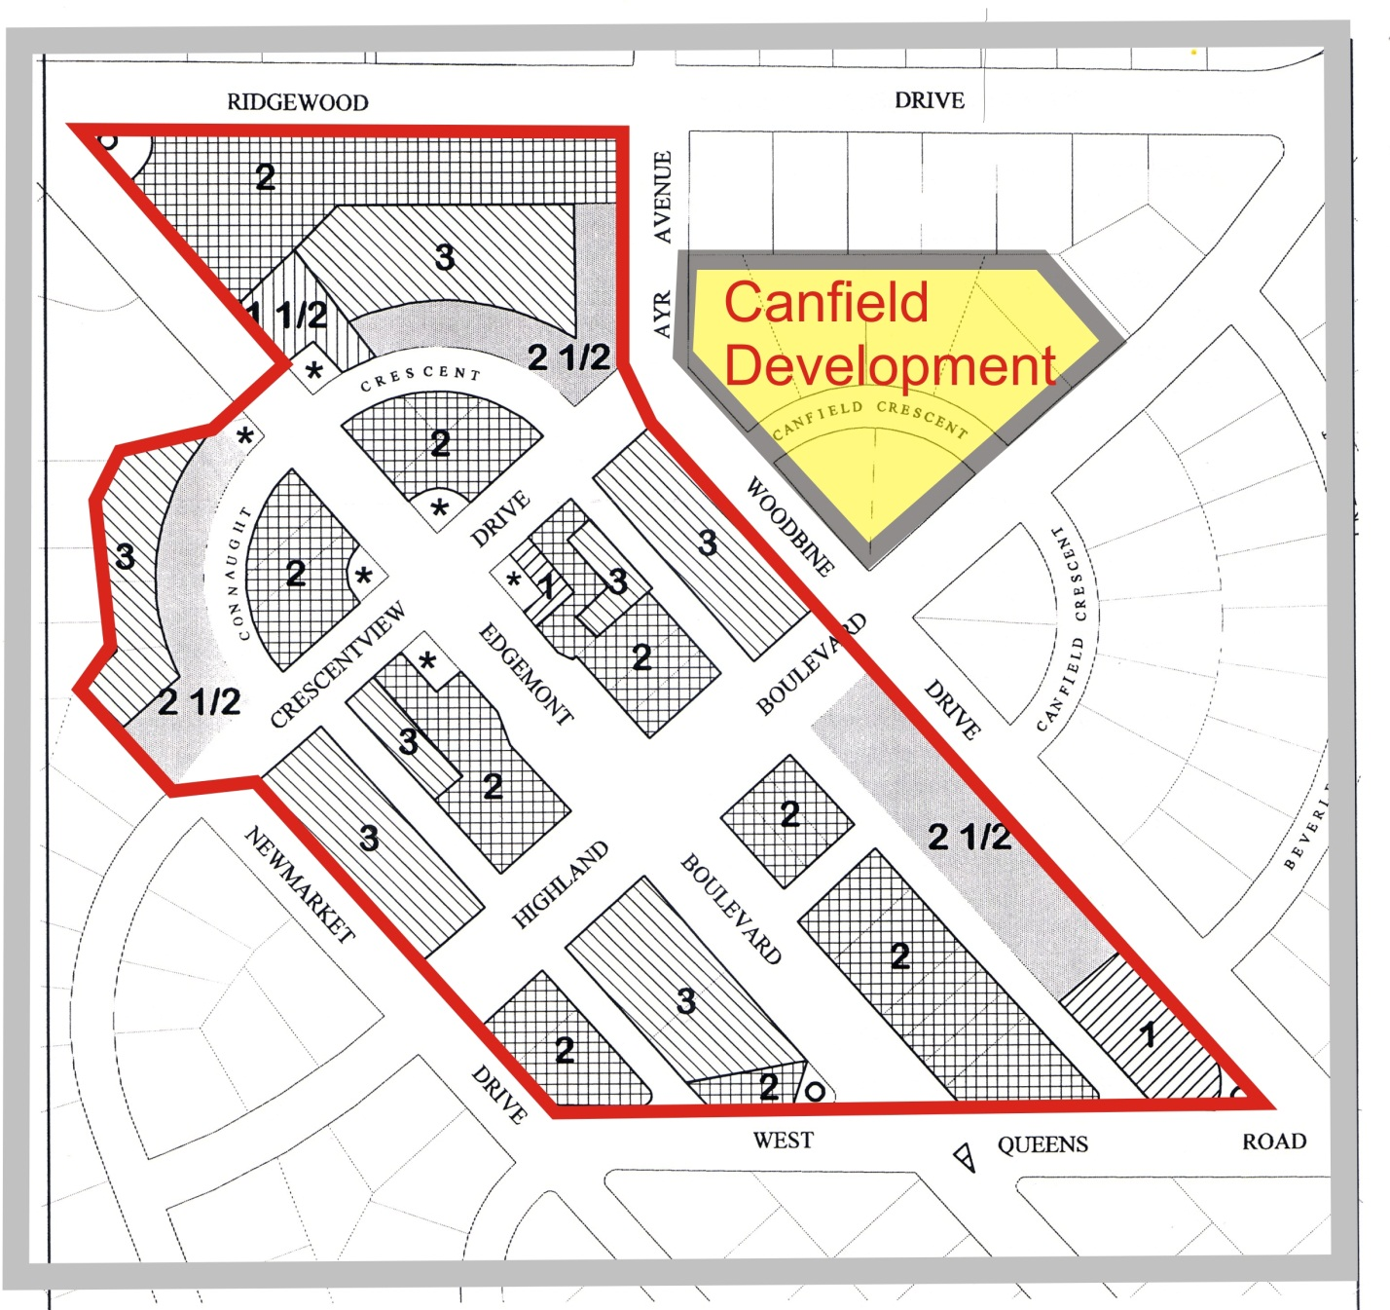
CANFIELD 130 Unit Independent Seniors Rental Proposal
Presented by
Chuck Brooks

Slide 6
COFFEE (Courtesy Delany’s)
$10 Subscriptions for 2012 now being received

Slide 7
Current Status of Potential Developments
Canfield Development
Preliminary Informal Discussion
Garden Works
Approved-In progress
Credit Union
In progress. Completion expected 2013-2014
Petro Canada
No current proposals. Old building demolished.
Super Valu
No current proposals.
Apartment Block Completion
No current proposals

Slide 8
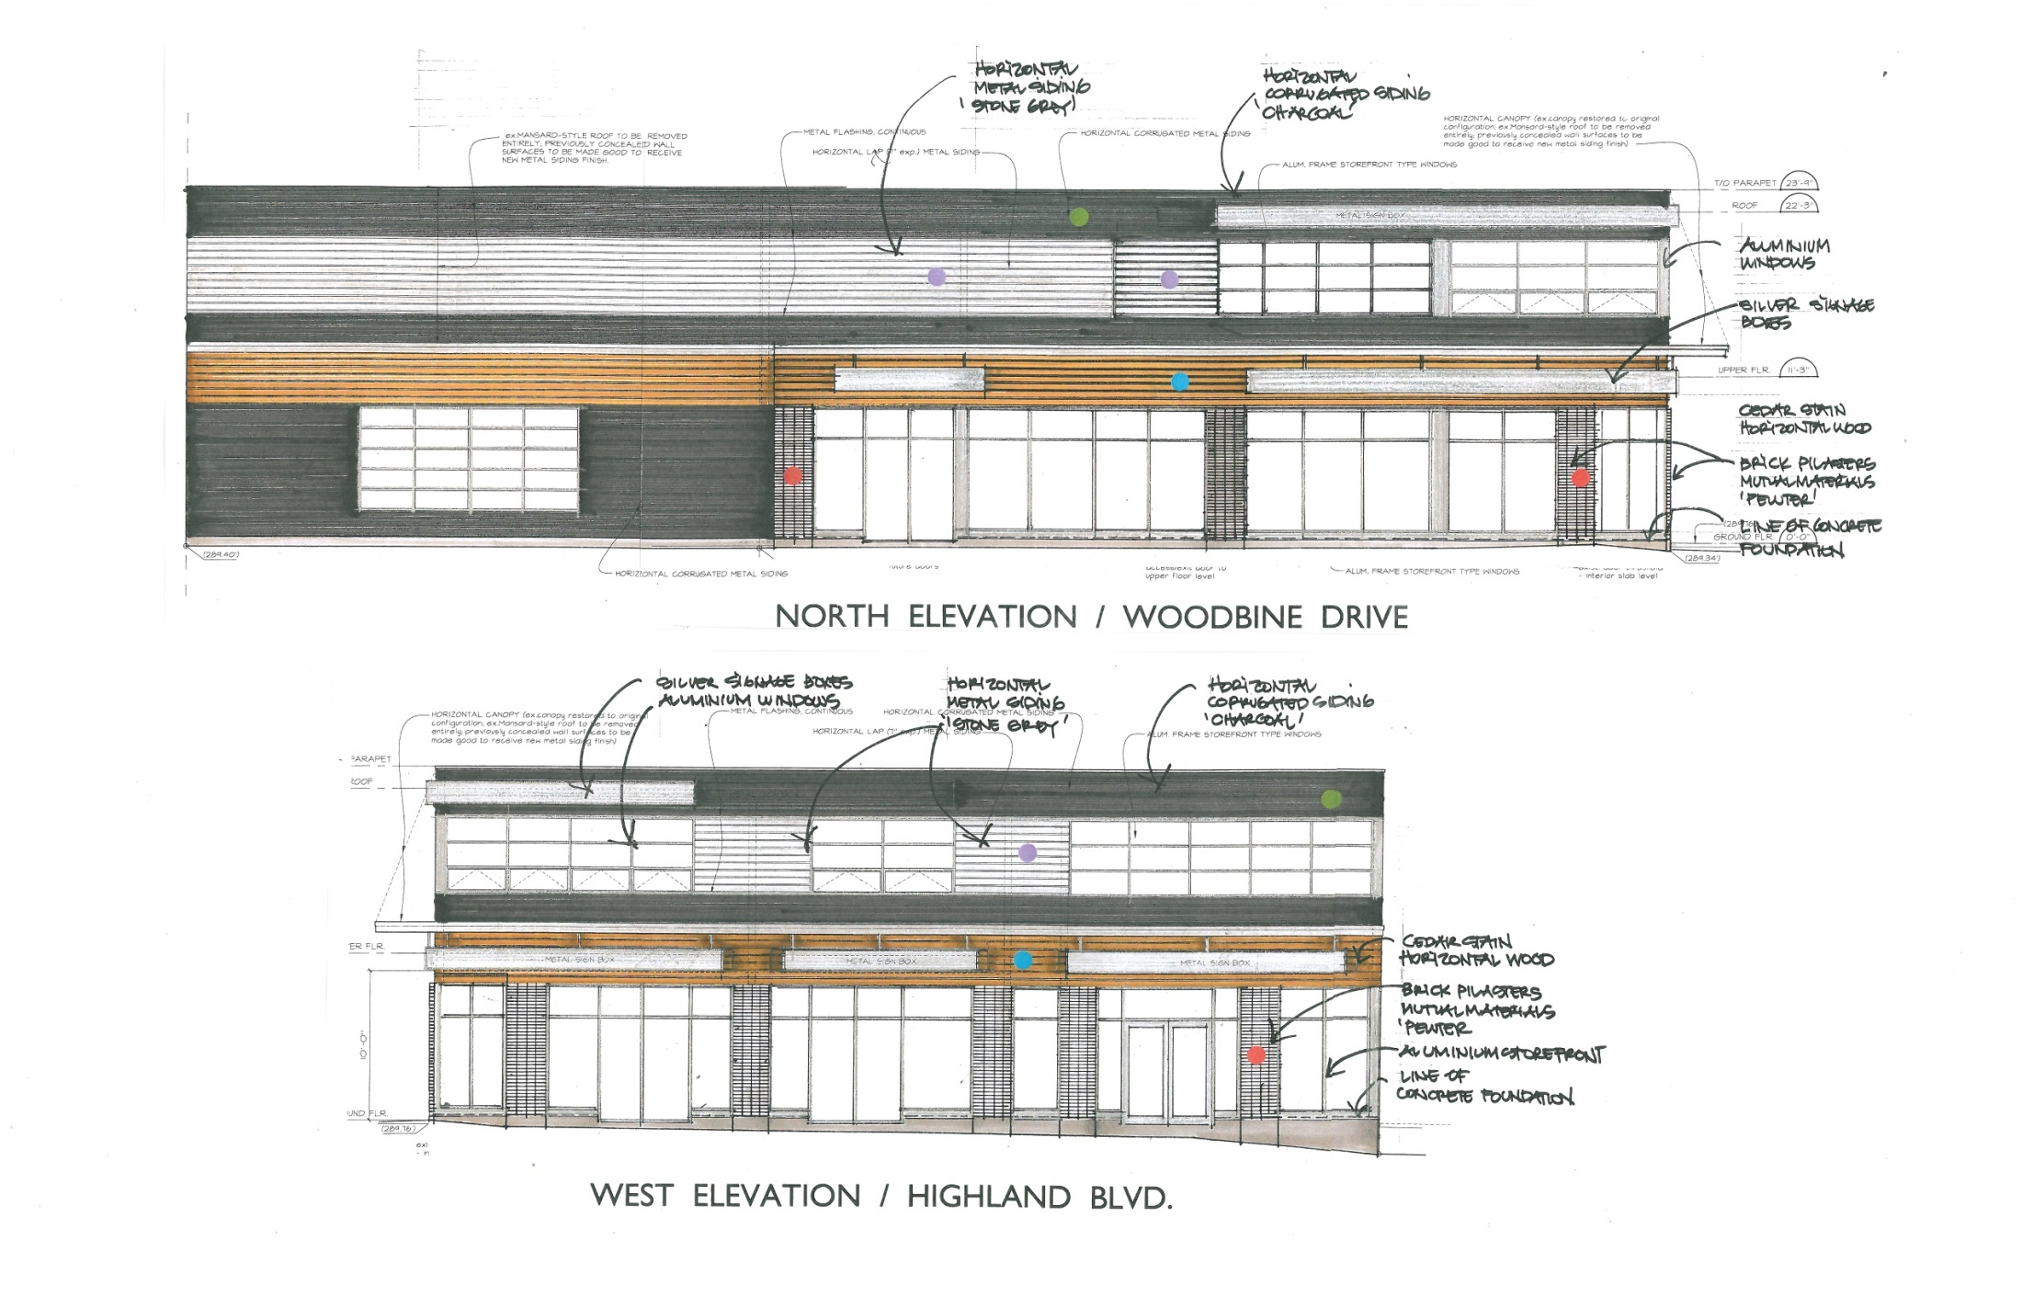
GARDEN WORKS Renovation

Slide 9
GENERAL UPPER CAPILANO DEVELOPMENT ISSUES

Slide 10
Delbrook/Griffin Recreation Centre Replacement – the Pool.
In 2009 the Rec Commission funded a report by RDH Consultants to list the repairs necessary to remediate the 35 year old Natatorium (swimming pool) at the Rec Centre. No cost estimates were provided.
The DNV has now requested an engineering estimate of the cost of these repairs to extend the life of the Natatorium for another 40 years. This will provide a crucial guide to the NEXT STEP.
Notes:
By BA

Slide 11
Delbrook/Griffin Recreation Centre Replacement
NEXT STEP Requested
A Feasibility Study should be carried out with capital and operating cost estimates for an appropriate range of options for upgrading the combined facility (current estimated cost $49,000,000 ) including:
Construction of a new building or buildings
Repair and upgrading of existing buildings
Feasible combinations of both option 1 & 2
Land use opportunities at both the Delbrook and Griffin sites
The various choices should be placed before the community together with the funding options and tax implications for each to gauge public support and guide the final selection.

Slide 12
Notes:
By Peter

Slide 13
IMPACT of NEW OCP on EDGEMONT VILLAGE
Notes:
By Grig

